Slide 1
Simple Framework for Contrastive Learning of Visual Representation

Slide 2
Problem Statement:
Learning effective visual representation without human supervision is a long standing problem.
Two approaches help in learning visual representations:
Generative approach – a computationally expensive approach
Discriminative approach – limits the generality of the learned representations due to dependence on heuristics to design pretext tasks.
Discriminative approach based on Contrastive learning(CL) shows promising results.
A simple framework for CL is proposed (SimCLR)

Slide 3
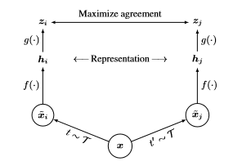

Major Components of SimCLR:
Composition of multiple data augmentation methods
Introduces a learnable non linear transformation between the representations and the contrastive loss
Normalized cross entropy loss with adjustable temperature parameter.
Larger batch sizes and longer training
Deeper and Wider networks

Slide 4
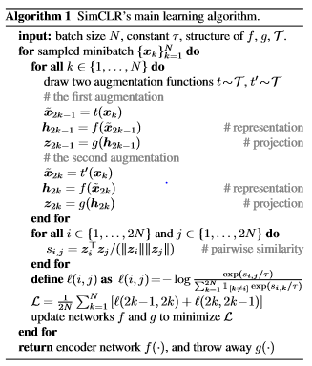
SimCLR’s learning algorithm:
f(.) is a ResNet encoder – extracts representations from the augmented sample
g(.) is the non linear projection head (MLP with one hidden layer)
zi = g(hi) = W(2)σ(W(1)hi) => σ – ReLU

Slide 5
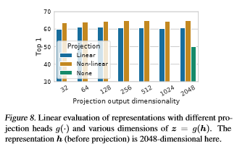
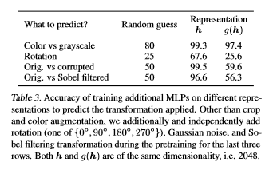
Architecture of Encoder and Head:

Slide 6
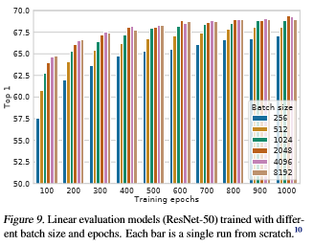
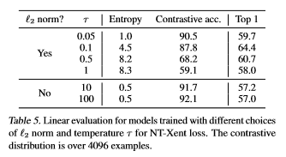
Loss Functions and Batch sizes:

Slide 7
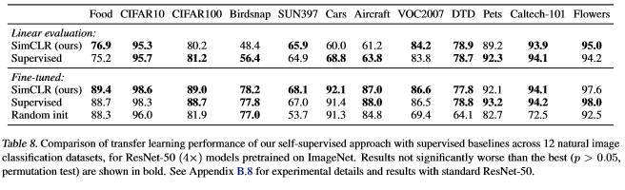
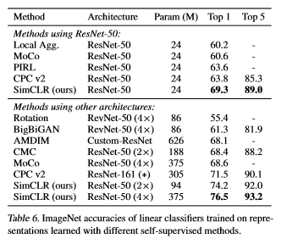
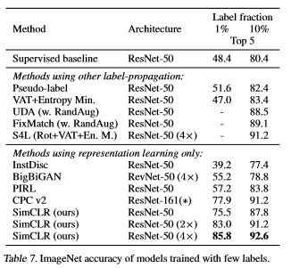
Comparison with State of the Art:

